Slide 1
Hardwired
When the control signal are generated by hardware using conventional logic design technique ,the control unit is said to be hardwired

Slide 2
Micro programmed control unit
A control unit whose binary control variable are stored in memory is called micro programmed control unit.

Slide 3
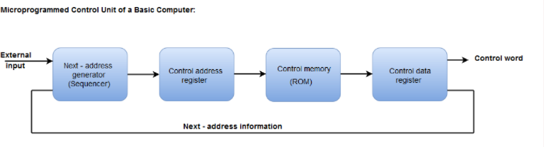
Micro-programmed Control
The following image shows the block diagram of a Microprogrammed Control organization.

Slide 4
The Control memory address register specifies the address of the micro-instruction.
The Control memory is assumed to be a ROM, within which all control information is permanently stored.
The control register holds the microinstruction fetched from the memory.
The micro-instruction contains a control word that specifies one or more micro-operations for the data processor.
While the micro-operations are being executed, the next address is computed in the next address generator circuit and then transferred into the control address register to read the next microinstruction.
The next address generator is often referred to as a micro-program sequencer, as it determines the address sequence that is read from control memory.

Slide 5
Microoperation
Microoperation performs basic operation on data stored in one or more registers including transferring data between registers or between register and external buses of the central processing unit ,and performing arithmetic and logical operation on register.

Slide 6
Design of Basic Computer
The basic computer consists of the following hardware components:
1. A memory unit with 4096 words of 16 bits each
2. Nine registers: AR, PC, DR, AC, IR, TR, OUTR, INPR, and SC
3. Seven flip-flops: I, S, E, R, lEN, FGI, and FGO
4. Two decoders: a 3 x 8 operation decoder and a 4 x 16 timing decoder
5. A 16-bit common bus
6. Control logic gates
7. Adder and logic circuit connected to the input of AC

Slide 7
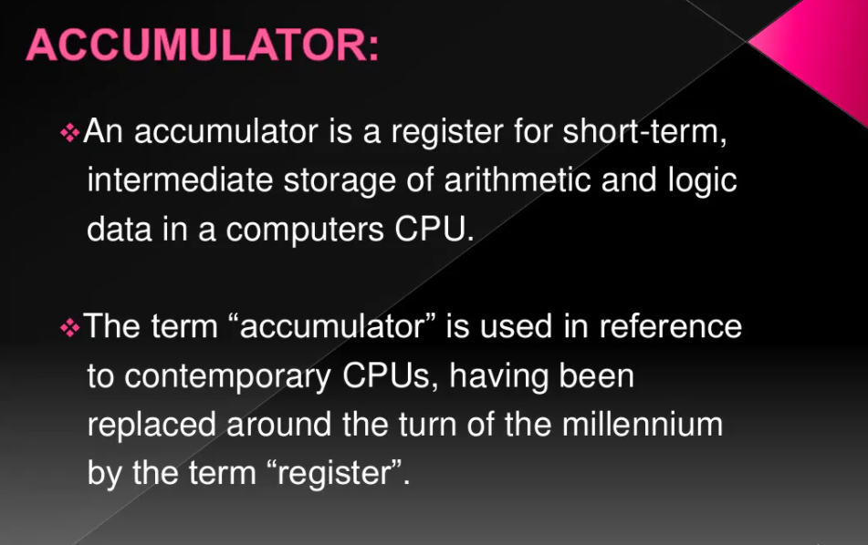
Design of Accumulator

Slide 8
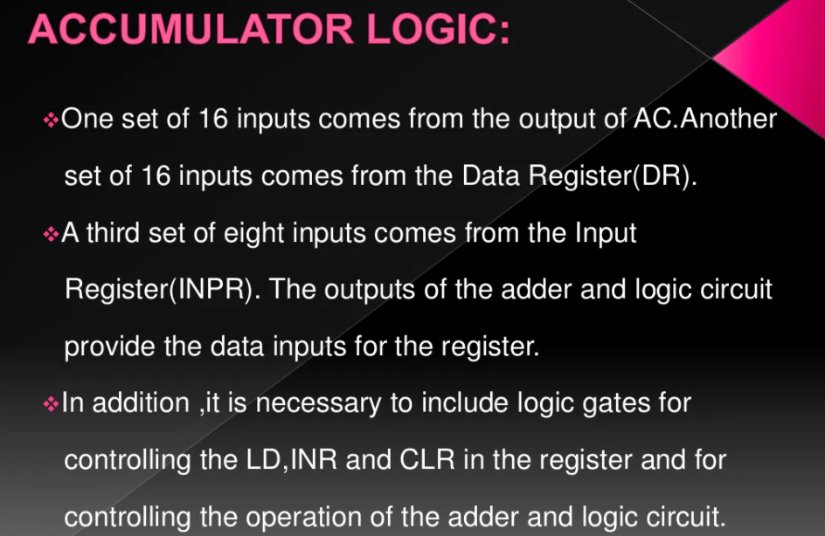

Slide 9
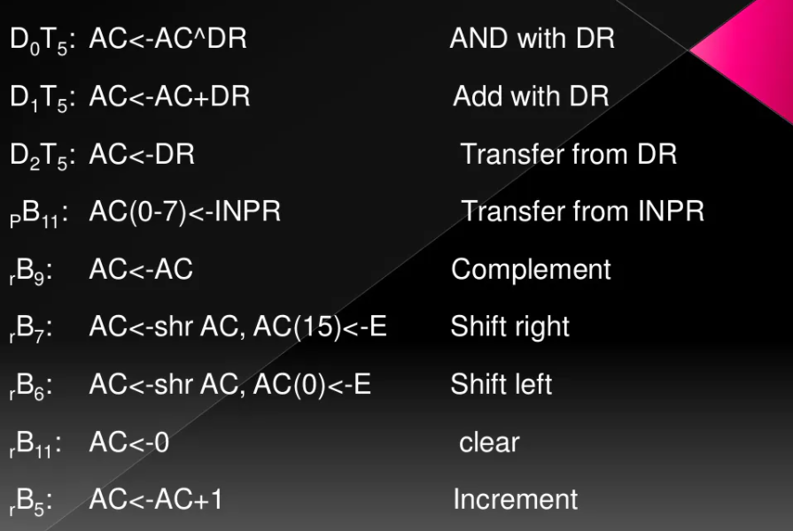

Slide 10
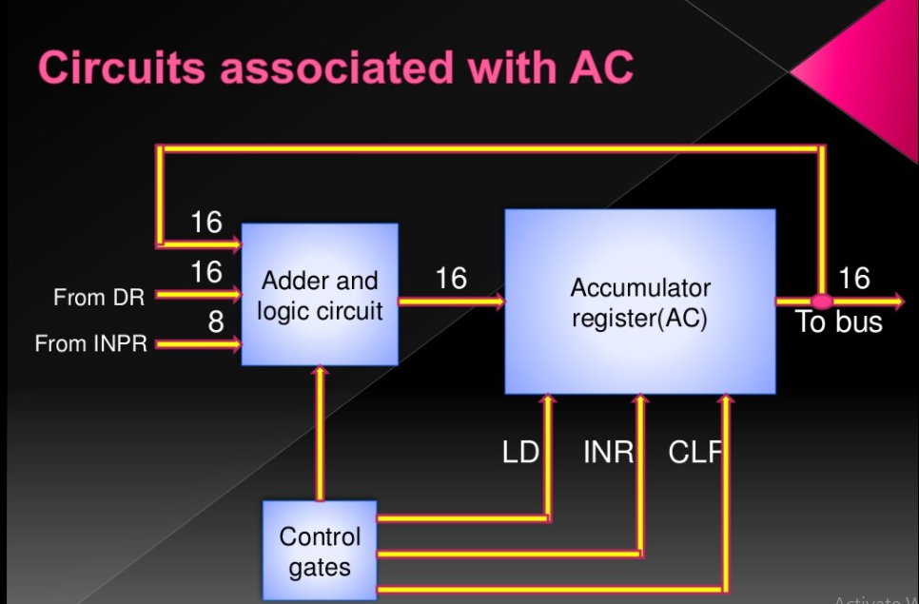

Slide 11
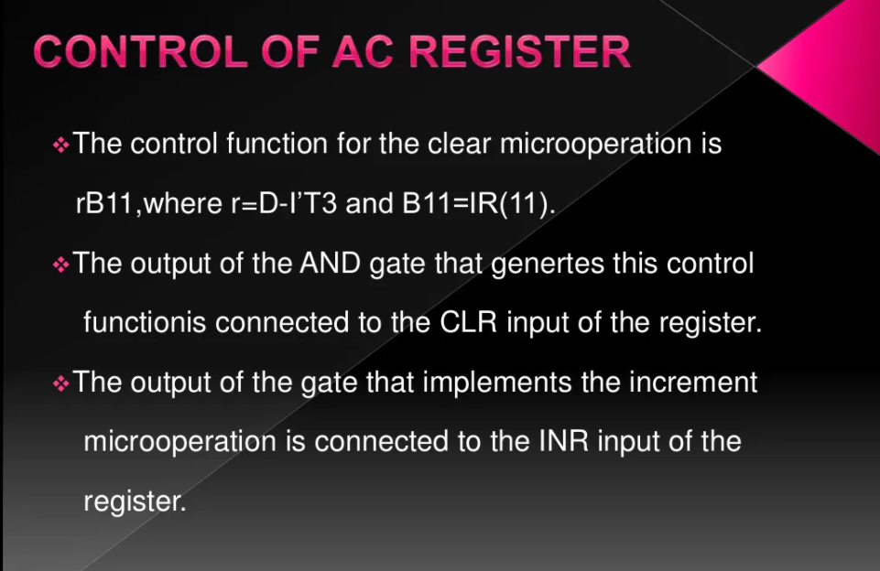
Control of AC register

Slide 12
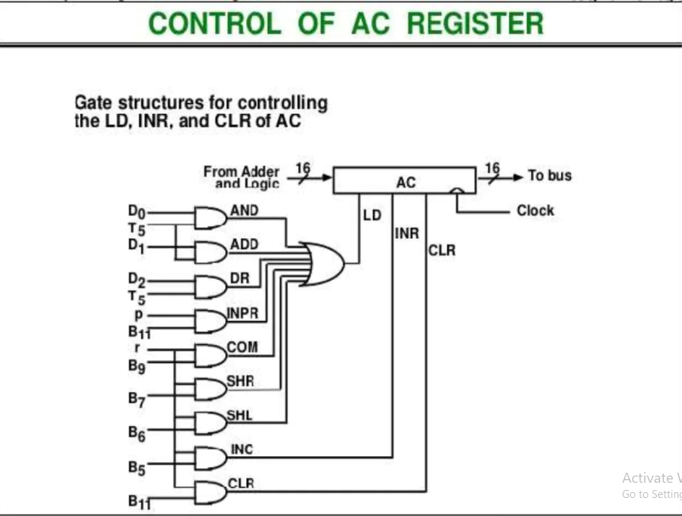

Slide 13
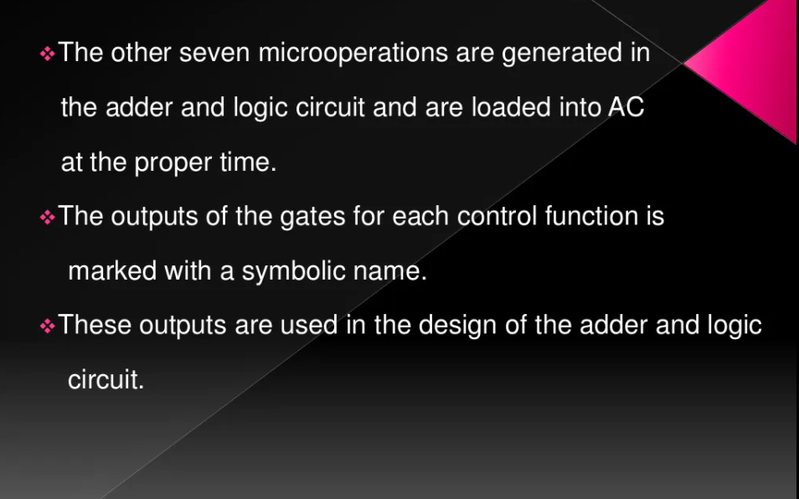

Slide 14
ALU organization
Various circuit are required to process data or perform arithmetic operation which are connected to microprocessor ALU
Accumulator and data Buffer stores data temporarily. These data are processed as per the control instruction to solve problem such as addition,multiplication etc

Slide 15
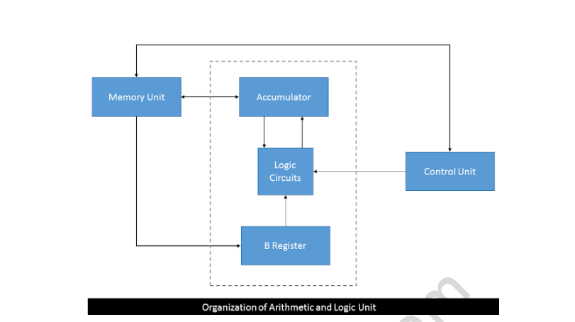

Slide 16
Function of ALU
ALU can be categorized into following 3 categories
1.Arithmetic operation:Addition ,Multiplication etc are example of arithmetic operation.Finding greater than or smaller than or equality between two number is also the form of arithmetic operation.
Logical Operation: Operation like AND,OR,NOR,NOT etc using logical circuit are the example of logical operation.
Data Manipulation: Operation such as flushing a register is an example of data manipulation.shifting binary number are also example of data manipulation.

Slide 17
Control Memory 1.The function of the control unit in a digital computer is to initiate sequence of microoperation.when the control signal are generated by hardware using conventional logic design technique, the control unit is said to be hardwired . Microprogramming is a second alternative for designing the control unit of a digital computer. 2.The principle of microprogramming is systematic method for controlling the microoperation sequences in a digital computer. 3.A control unit whose binary control variables are stored in memory is called Microprogrammed control unit. 4.A memory that is part of control unit is referred to as a control memory. Each word in control memory contains within its microinstruction .A sequence of microinstructin constitutes a microprogram . 5.To execute any instruction the microinstruction stored in its control memory must be executed.

Slide 18
Address Sequencing
The control memory is used to store the microinstructions in groups. Here each group is used to specify a routine.
The control memory of each computer has the instructions which contain their micro-programs routine.
These micro-programs are used to generate the micro-operations that will be used to execute the instructions

Slide 19
When the power of a computer is turned on, we have to first load an initial address into the CAR (control address register). This address can be described as the first microinstruction address. With the help of this address, we are able to activate the instruction fetch routine.
Then, the control memory will go through the routine, which will be used to find out the effective address of operand.
In the next step, a micro-operation will be generated, which will be used to execute the instruction fetched from memory.
We are able to transform the bits of instruction code into an address with the help of control memory where routine is located. This process can be called the mapping process. The control memory required the capabilities of address sequencing, which is described as follows:

Slide 20
On the basis of the status bit conditions, the address sequencing selects the conditional branch or unconditional branch.
Addressing sequence is able to increment the CAR (Control address register).
It provides the facility for subroutine calls and returns.
A mappings process is provided by the addressing sequence from the instructions bits to a control memory address.

Slide 21
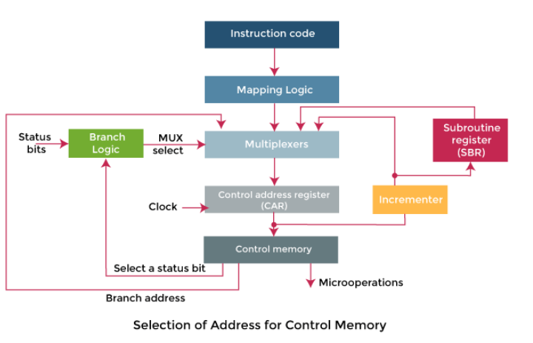

Slide 22
In the above diagram, we can see a block diagram of a control memory and associative hardware, which is required for selecting the address of next microinstruction. The microinstruction is used to contain a set of bits in the control memory. With the help of some bits, we are able to start the micro-operations in a computer register. The remaining bits of microinstruction are used to specify the method by which we are able to obtain the next address.
In this diagram, we can also see that the control address register are able to recover their address with the help of four different directions. The CAR is incremented with the help of incrementer and then chooses the next instruction. The branching address will be determined in the multiple fields of microinstruction so that they can provide results in branching.

Slide 23
Conditional Branching
Conditional branching is obtained by using part of the microinstruction to select a specific status bit in order to determine its condition.
The status conditions are special bits in the system that provide parameter information such as the carry-out of an adder, the sign bit of a number, the mode bits of an instruction, and i/o status conditions.
The status bits, together with the field in the microinstruction that specifies a branch address, control the branch logic.
The branch logic hardware may be implemented by multiplexer. If the selected status bit in the 1 state ,the output of the multiplexer is 1;otherwise 0.
A 1 output in the multiplexer generates a control signal to transfer the branch address from the micro-instruction into the control address register .A 0 output in the multiplexer causes the address register to be incremented
Branch to indicated address if the condition is met. Otherwise , the address register is incremented.
If there are 8 status bit conditions, then 3 bits in the microinstruction are used to specify the condition and provide the selection variables for the multiplexer.
For unconditional branching, fix the value of one status bit to be one load the branch address from control memory into the CAR.

Slide 24
Mapping of instruction
A special type of branch exists when a microinstruction specifies a branch to the first word in control memory where a microprogram routine is located.
The status bits for this type of branch are the bits in the opcode.
Assume an opcode of four bits and a control memory of 128 locations.
The mapping process converts the 4-bit opcode to a 7-bit address for control memory shown in below figure.
Mapping consists of placing a 0 in the most significant bit of the address, transferring the four operation code bits, and clearing the two least significant bits of the control address register.
This provides for each computer instruction a microprogram routine with a capacity of four microinstructions.
Mapping logic
-CAR(0,1,6)<-0
CAR(2,5)<-IR(11-14)

Slide 25
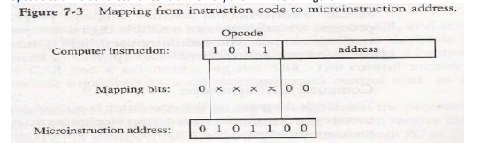

Slide 26
Subroutines
Subroutine are program that are used by other routine to accomplish a particular task.
Microinstruction can be saved by employing subroutine that use common sections of microcode.
The subroutine register(SBR) can then become the source for transferring the address for the return to the main program.
For example,the sequence of micro-operations needed to generate the effective address of the operand for instruction is common to all memory reference instruction. This sequence could be a Subroutine that is called from within many other routines to execute the effective address computation.

Slide 27
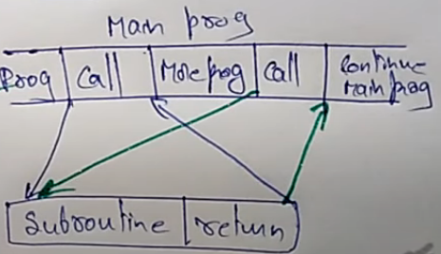
Subroutine

Slide 28
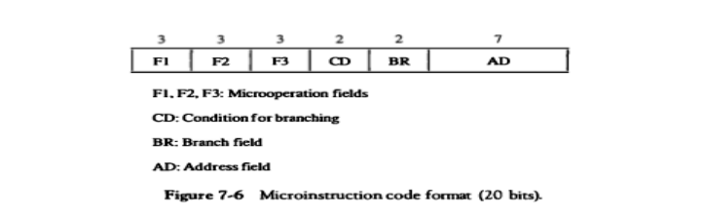
Micro instruction format

Slide 29
Micro instruction format
The microinstruction format for control memory is shown below.
The 20 bit of the microinstruction are divided into four functional parts
The three fields F1,F2 and F3 specify micro-operation for the computer
The CD field select status bit
The BR field specified the type of branch to be used.
The AD field contains the branch address
The address field is seven bit wide ,since thecontrol memory has 128=2^7 words.

Slide 30
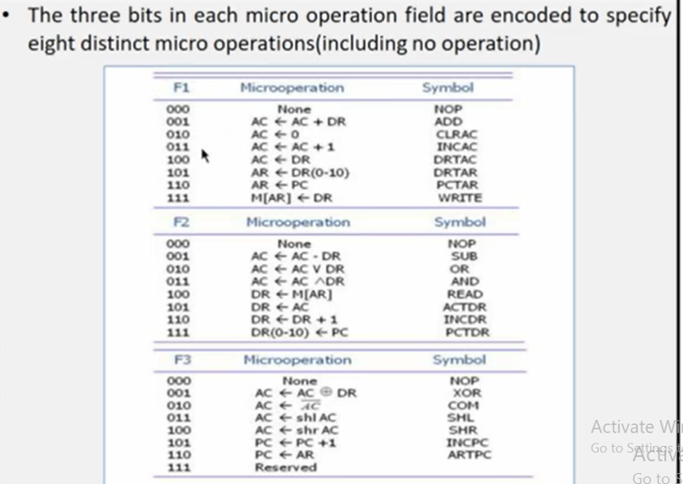

Slide 31
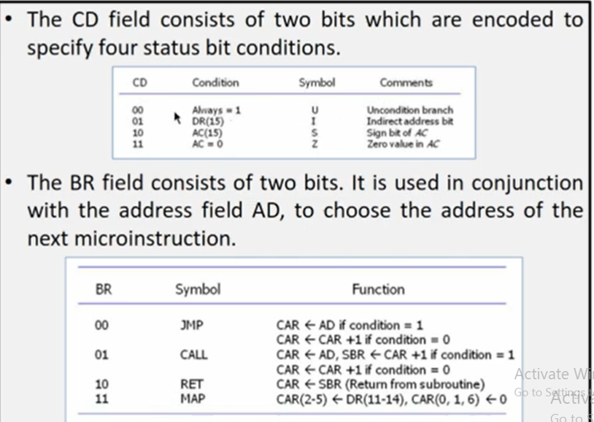

Slide 32
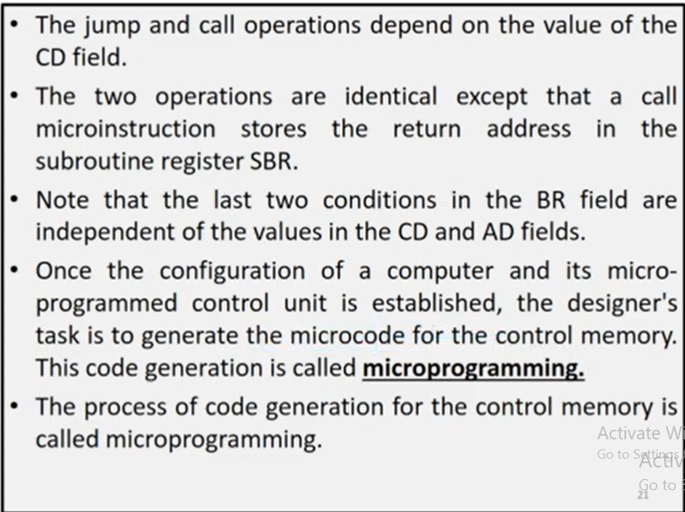

Slide 33
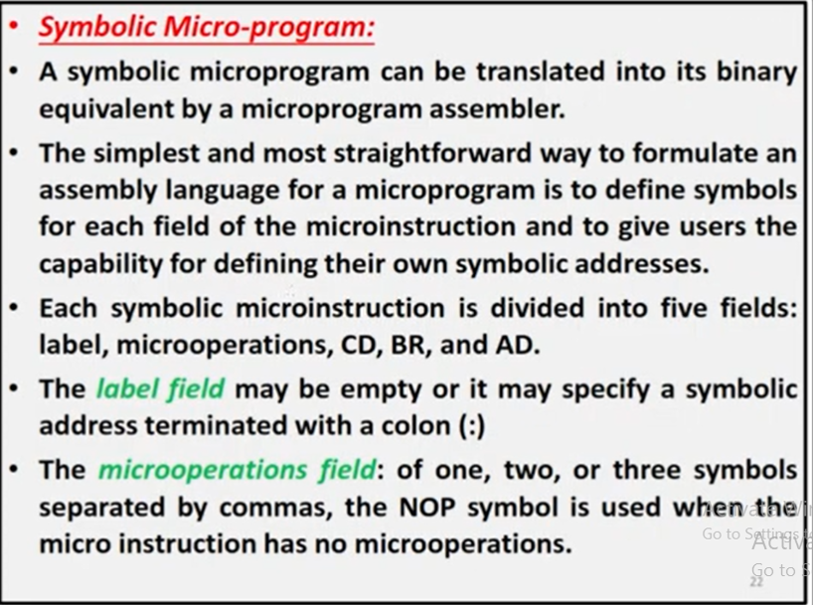

Slide 34
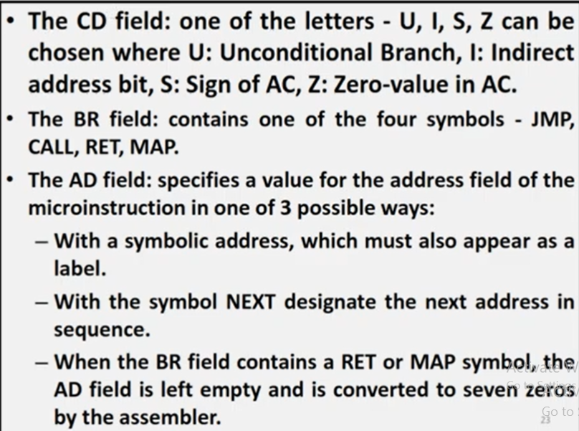

Slide 35
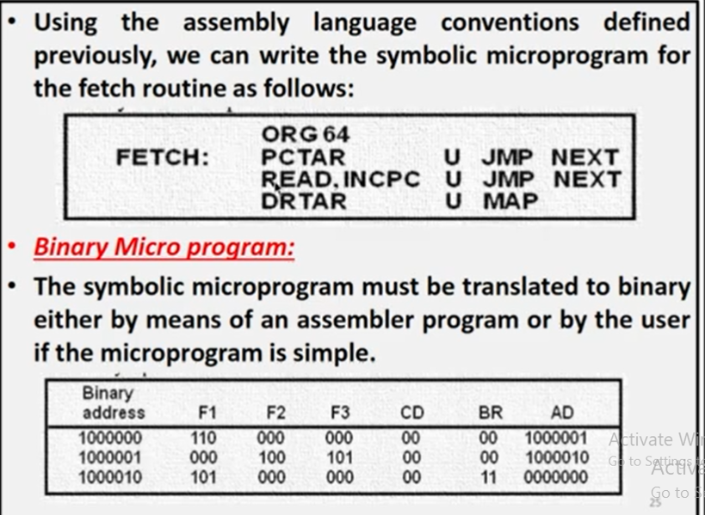

Slide 36
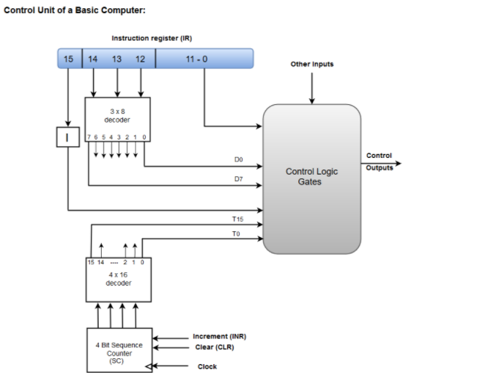

Slide 37
A Hard-wired Control consists of two decoders, a sequence counter, and a number of logic gates.
An instruction fetched from the memory unit is placed in the instruction register (IR).
The component of an instruction register includes; I bit, the operation code, and bits 0 through 11.
The operation code in bits 12 through 14 are coded with a 3 x 8 decoder.
The outputs of the decoder are designated by the symbols D0 through D7.
The operation code at bit 15 is transferred to a flip-flop designated by the symbol I.
The operation codes from Bits 0 through 11 are applied to the control logic gates.
The Sequence counter (SC) can count in binary from 0 through 15.

Slide 38
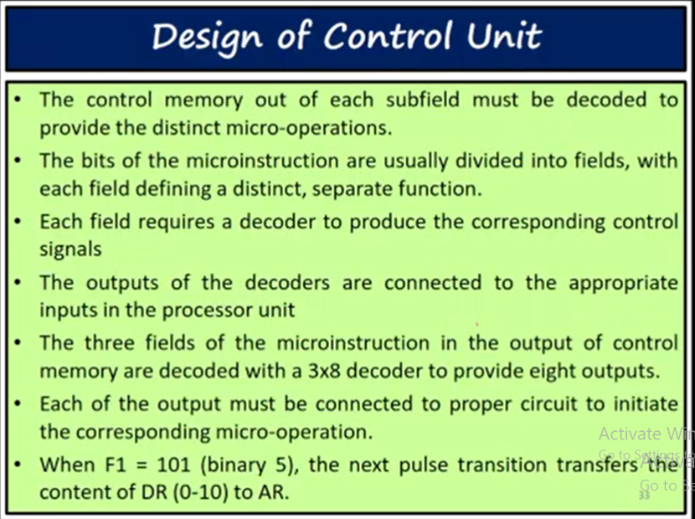

Slide 39
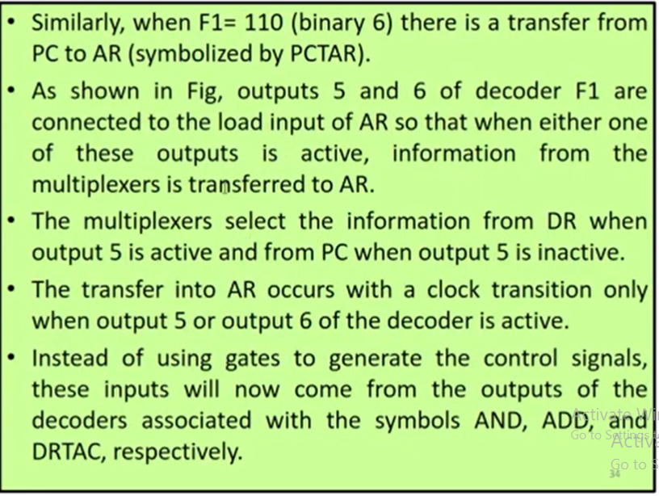

Slide 40
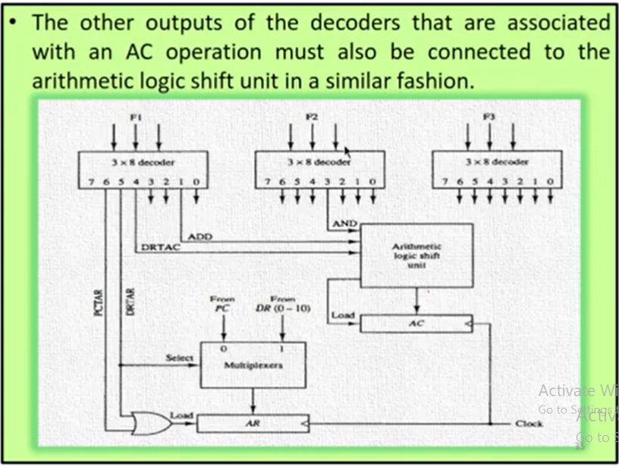

Slide 41
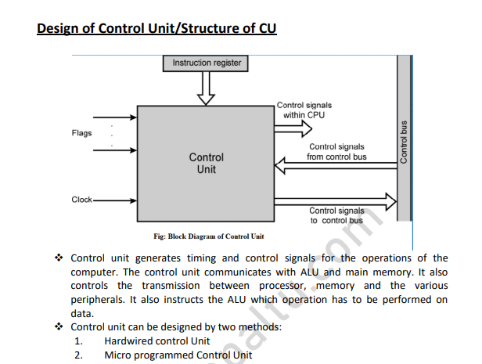

Slide 42
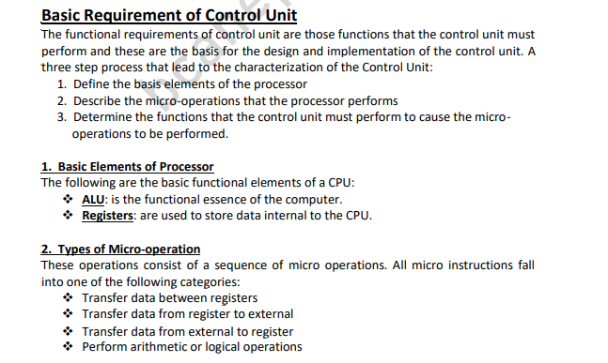

Slide 43
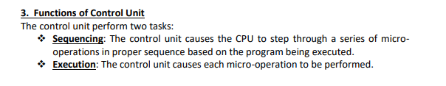

Slide 44
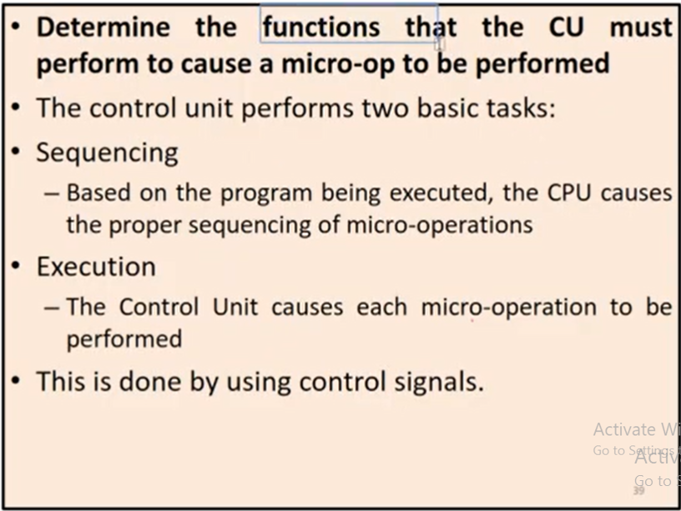

Slide 45
Micro programmed sequencer for a control Microprogram sequencer:
The first multiplexer selects an address from one of four sources and routes it into a control address register CAR
The second multiplexer tests the value of a selected status bit and the result of the test is applied to an input logic circuit.
The output from CAR provides the address for the control memory.
The content of CAR is incremented and applied to one of the multiplexer inputs and to the subroutine registers SBR.
The other three inputs to multiplexer 1 come from the address field of the present microinstruction, from the output of SBR, and from an external source that maps the instruction.
Although the figure 4.6 shows a single subroutine register, a typical sequencer will have a register stack about four to eight levels deep. In this way, a number of subroutines can be active at the same time.
The CD (condition) field of the microinstruction selects one of the status bits in the second multiplexer.
If the bit selected is equal to 1, the T (test) variable is equal to 1; otherwise, it is equal to 0
The T value together with the two bits from the BR (branch) field goes to an input logic circuit.
The input logic in a particular sequencer will determine the type of operations that are available in the unit.

Slide 46
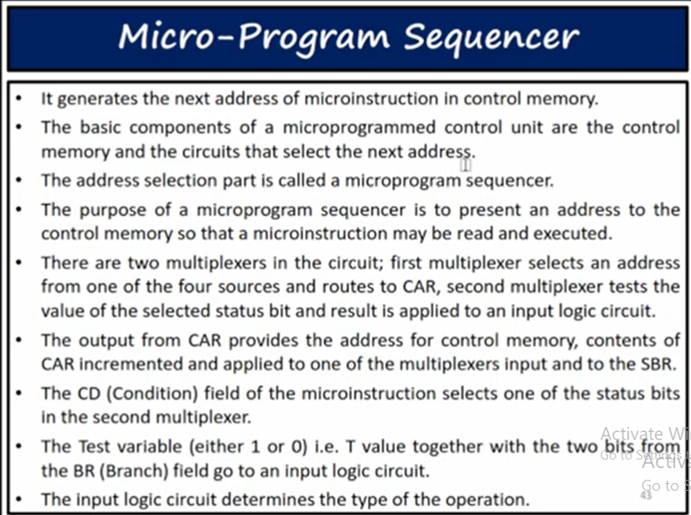

Slide 47
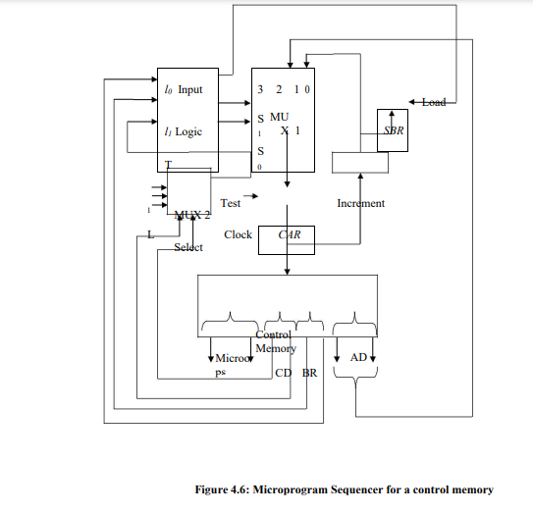

Slide 48
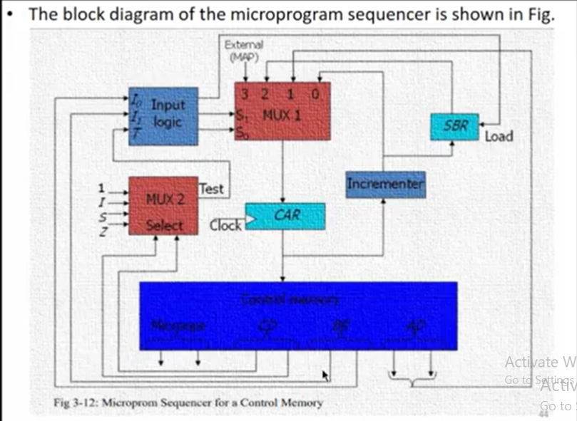

Slide 49
Typical sequencer operations are: increment, branch or jump, call and return from subroutine, load an external address, push or pop the stack, and other address sequencing operations.
With three inputs, the sequencer can provide up to eight address sequencing operations.
Some commercial sequencers have three or four inputs in addition to the T input and thus provide a wider range of operations.

